Slide 1

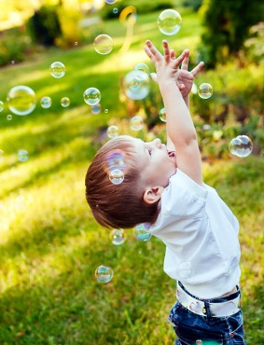
Let’s Play
Blow bubbles and encourage your child to bend low to pop the low bubbles and stretch up high to pop the high bubbles. Can they pop bubbles on their tip toes?
Ideas for Parents and Carers
Gross Motor Skills

Slide 2
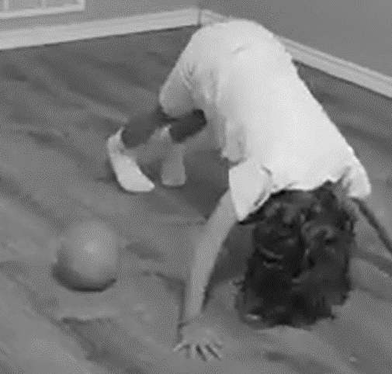
Let’s Play
Ideas for Parents and Carers
Gross Motor Skills
Ask your child to hold the bear pose position, then roll the ball under them for them to then collect.

Slide 3
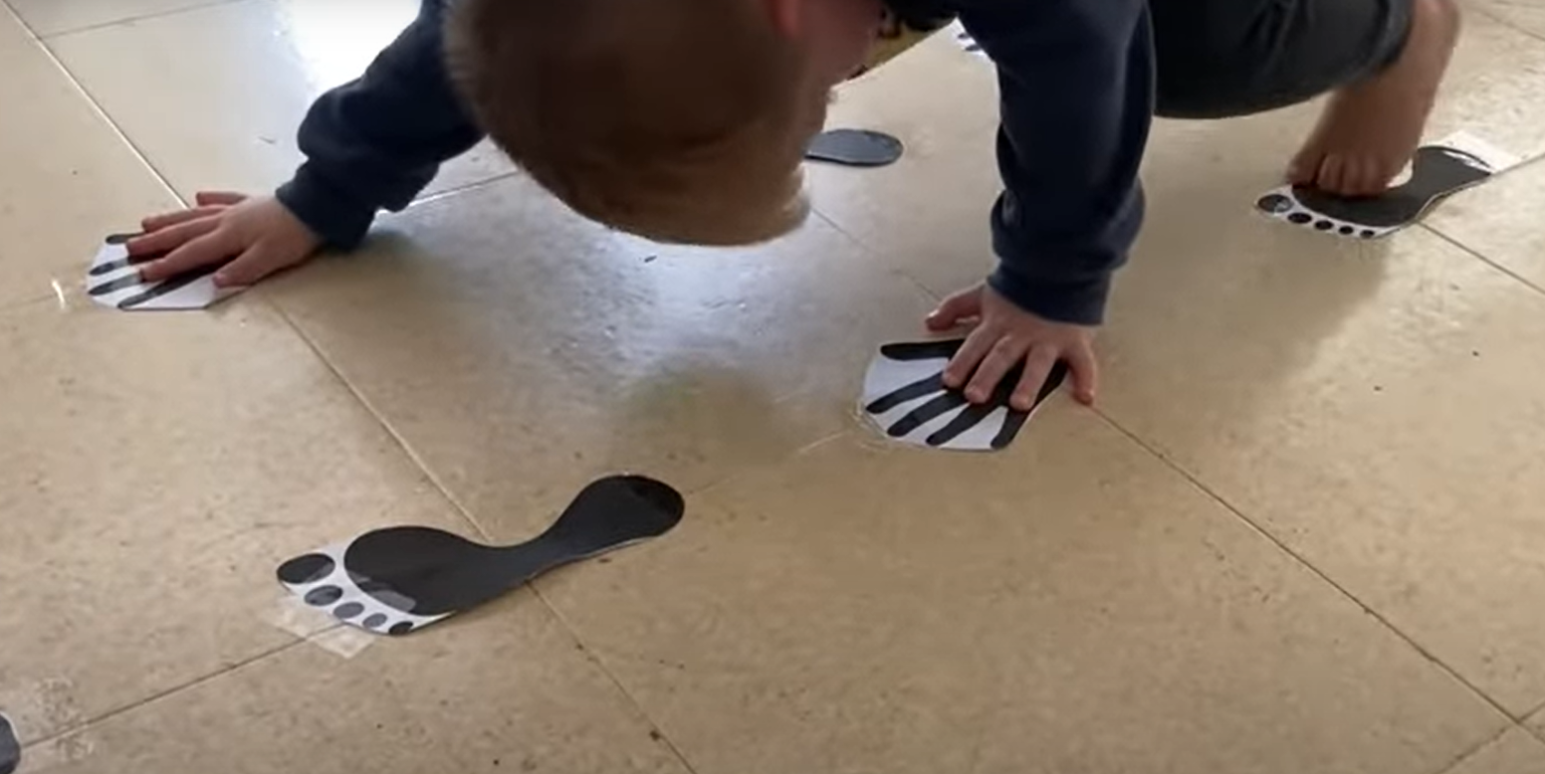
Let’s Play
Ideas for Parents and Carers
Gross Motor Skills
Print out hands and feet and see if your child can match them on the floor. You could even put some hands on the walls to see if they can stretch up tall.

Slide 4
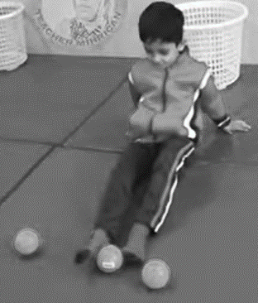
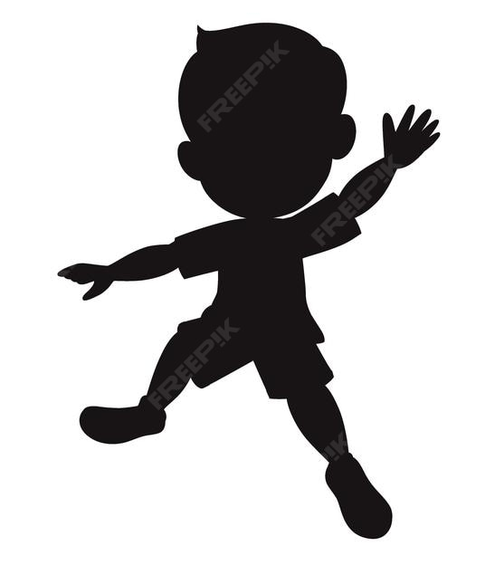
Let’s Play
Top Tip
If you don’t have balls, use rolled up socks or teddies.
Ideas for Parents and Carers
Gross Motor Skills
Can you lift the ball with your feet and place it in the tub behind you?

Slide 5
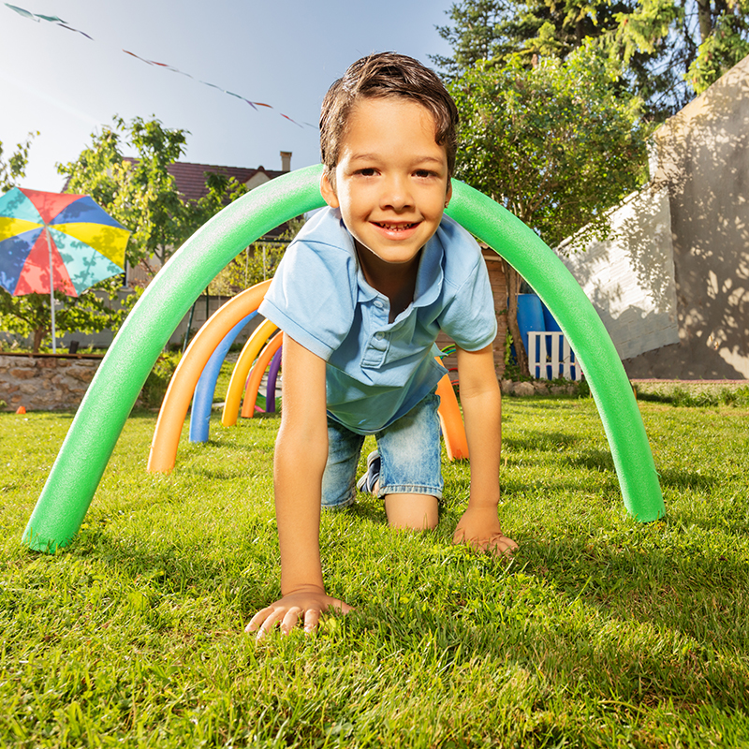
Not only is crawling a great exercise for core strengthening, but it also helps with strengthening shoulder stabilizers which in turn assists with improving ability to complete fine motor activities.
Easy: Crawl across flat surface.
Medium: Crawl across soft and squishy surface such as couch cushions.
Hard: Construct obstacle course, crawling over and under couch cushions, for example.
Let’s Play
Ideas for Parents and Carers
Gross Motor Skills
Let’s Crawl

Slide 6
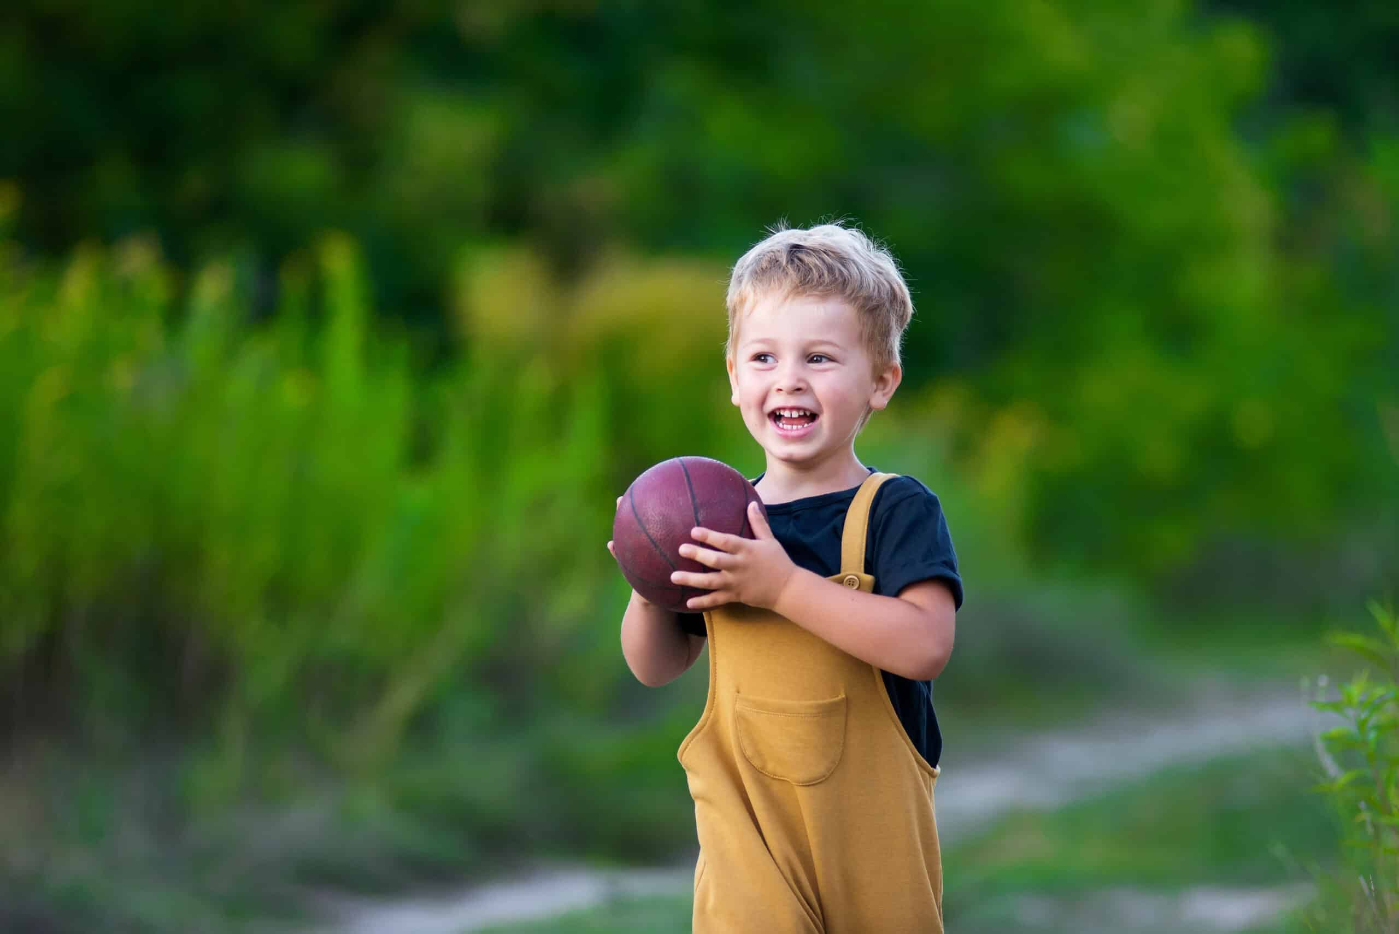
Let’s Play
Ideas for Parents and Carers
Gross Motor Skills
Play with a ball!
Can you roll and stop together?
Can you throw and catch together?
Can you kick the ball together?

Slide 7
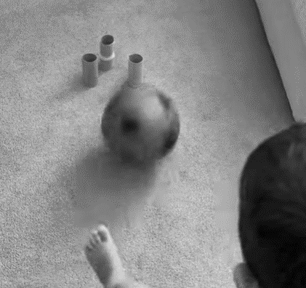
Let’s Play
Ideas for Parents and Carers
Gross Motor Skills
Set up toilet roll tubes. How many can your child kick down?

Slide 8
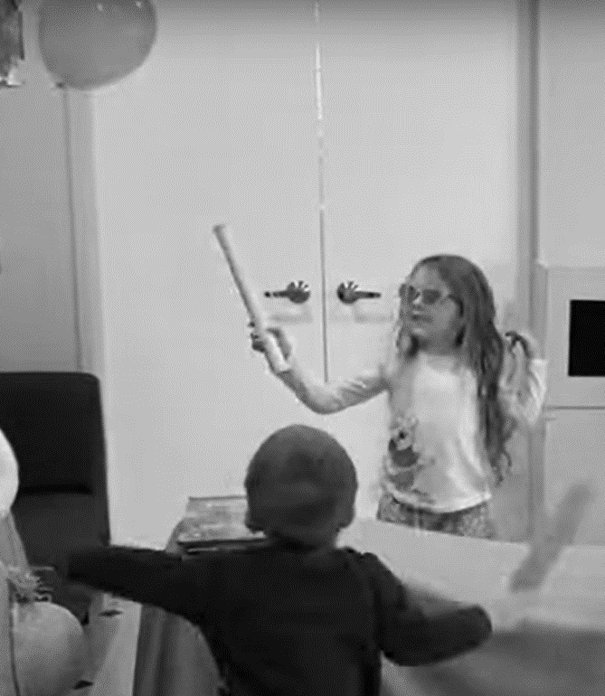
Let’s Play
Ideas for Parents and Carers
Gross Motor Skills
Click here for the video link:
PLAY INSPIRATION | Ultimate Rainy Day Survival: 10 Indoor Game Ideas for Kids!

Slide 9
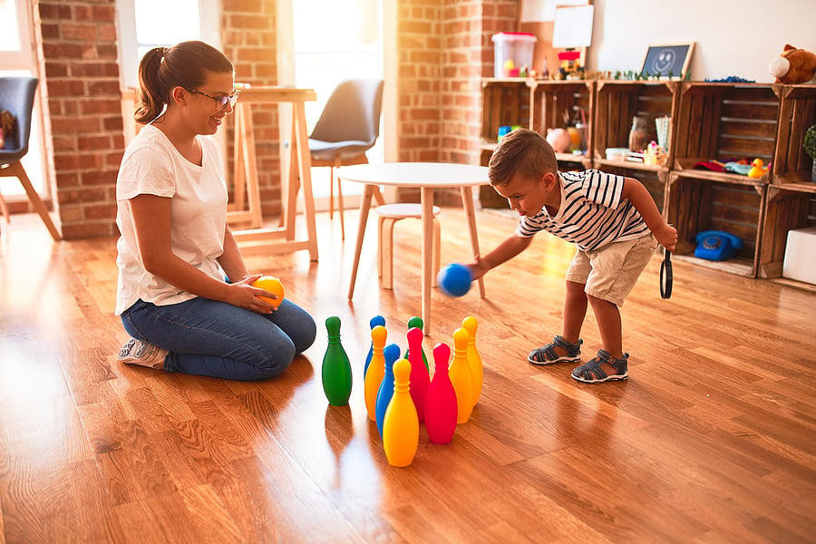
Let’s Play
Ideas for Parents and Carers
Gross Motor Skills
Skittles is a great rolling game to play together.

Slide 10
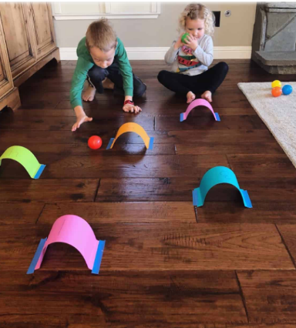
Let’s Play
Ideas for Parents and Carers
Gross Motor Skills
Make tunnels together and roll the balls through.

Slide 11
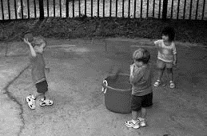
Let’s Play
Top Tip
If you don’t have balls, use rolled up socks or scrunched up paper.
Ideas for Parents and Carers
Gross Motor Skills
Throw a ball into a tub.

Slide 12
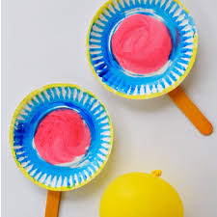
Let’s Play
Ideas for Parents and Carers
Gross Motor Skills
Balloon Tennis!
Always supervise balloon play and dispose of popped balloons immediately.

Slide 13

Music
Gross Motor Skills
Have you thought about performing nursery rhymes with actions or dancing to develop gross motor skills?
Top Tip
For the Grand Old Duke of York. March and bend up and down.
Ideas for Parents and Carers

Slide 14
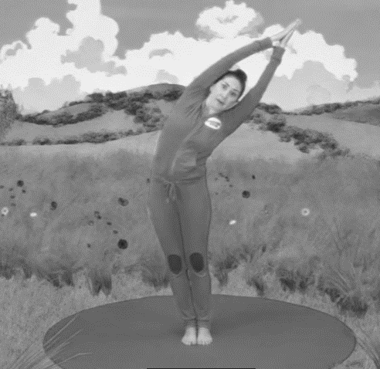
https://www.youtube.com/watch?v=KAT5NiWHFIU
Let’s Play
Ideas for Parents and Carers
Gross Motor Skills
Click here for the video link:
https://www.youtube.com/watch?v=KAT5NiWHFIU

Slide 15
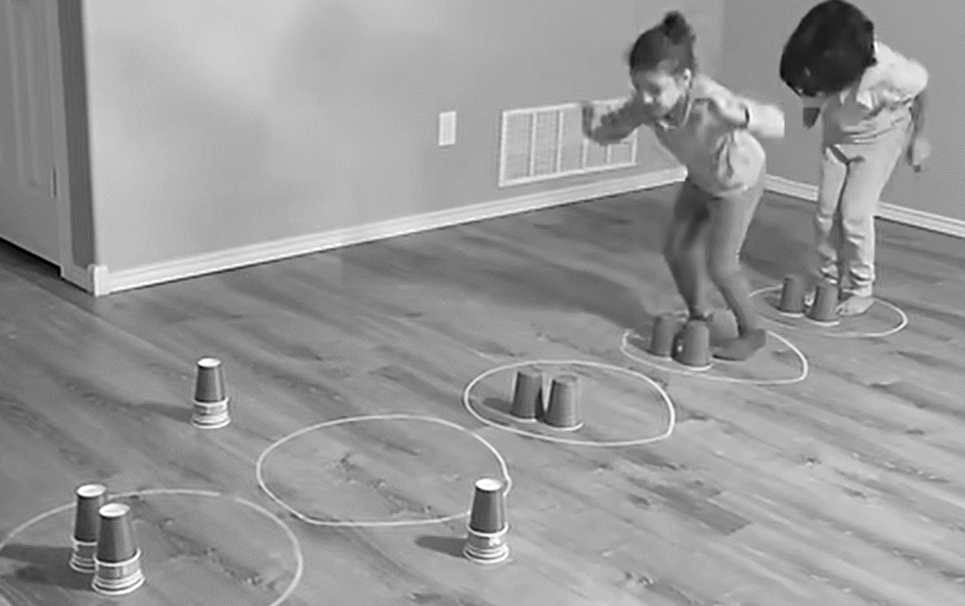
Let’s Play
Top Tip
Progress to landing on two feet balanced.
Ideas for Parents and Carers
Gross Motor Skills
Click here for the video link:
Jumping game | pe games and activities for kids | Primary school and elementary school

Slide 16
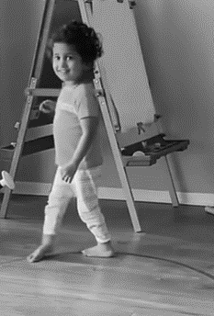
Top Tips
Change
1-The pathways, you could try zig zags or straight lines too.
2-The direction of travel, you could travel sideways or backwards too.
Let’s Play
Ideas for Parents and Carers
Gross Motor Skills
Click here for the video link: Fun indoor activities to develop your child’s balance and much more!Video courtesy @maanviandme3657

Slide 17
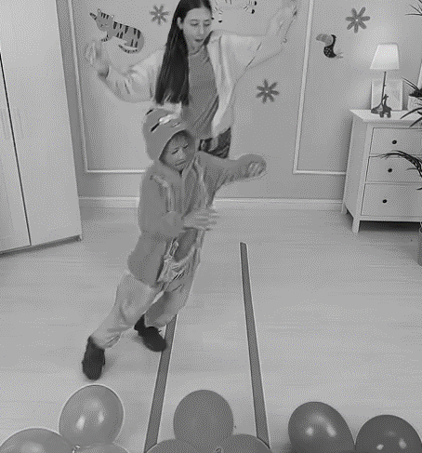
Let’s Play
Ideas for Parents and Carers
Gross Motor Skills
Click here for the video link: https://www.youtube.com/shorts/sSgEPc5NUgw

